Slide 1

DOS or DDOS Attack
Sameer Ansari

Slide 2



Agenda
What is DOS
What is DDOS
Recent Web attack on web
Method of attack
Performing DOS attack
How do we know attack is happening ?
What to do if we are experiencing an attack ?
How do we avoid being part of the problem ?
Conclusion

Slide 3




DOS
DOS stands for Denial of Services. It is an attack to make a machine or network resource unavailable to its intended users.

Slide 4

D-DOS
D-Dos stands for Distributed Denial of service attack. It is an attack or network resources unavailable to its intended by using other computer.

Slide 5
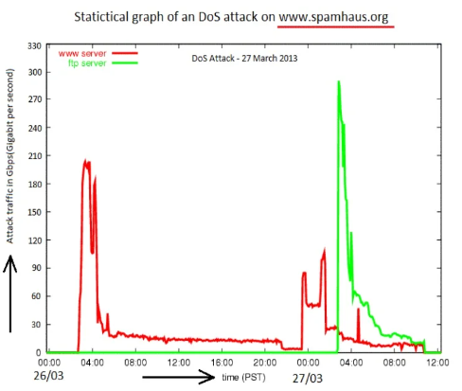
A big bang of DDOS attack
The internet around the world was slowed down on 27th march.
Because that day DDOS attack took place with near about 300Gbps.

Slide 6
Some best DOS attack
Github in 2018 1.3 tera bit per second not involved botless involved database caching it uses DDOS protection recover in 10 minute.
Netflix, Amazon, Spoti DNS provider attacked
Hongkon pro democracy office Pop vote botnet.

Slide 7
Methods of attack
ICMP flood Teardrop attack Permanent denial-of service attack | Reflected / Spoofed attack Low-rate Denial-of service attack Peer to peer attack

Slide 8

Some best DOS attack method
ICMP flood sends packets to all the computer hosts rather than a specific machine
Teardrop attacks : fragmented over sized pay-loads to be send to the target machine.
Permanent denial-of –service attack : It may cause replacement of hardware also.

Slide 9
Performing DOS or DDoS attack
A wide range of programs are used to launch DOS attack some of these are .
Jolt
Bubonic
Targa
Blast
Panther
Crazy Pinger

Slide 10
Some best DOS attack tools
Jolt : finds exploit vulnerability in windows networking code. Consums100% CPU time by sending heavy CPU consuming packets
LaTierra : it sends TCP packet to more than one port number
Nemsey : generates random packets with random port number and floods victim with it.

Slide 11
How do we know an attack is happening ?
Here are the list
Unsually slow network performance ( opening files or accessing websites).
Unavailability of a particular website.
Inability to access any website.
Dramatic increase in the amount of spam you receive in your account.

Slide 12
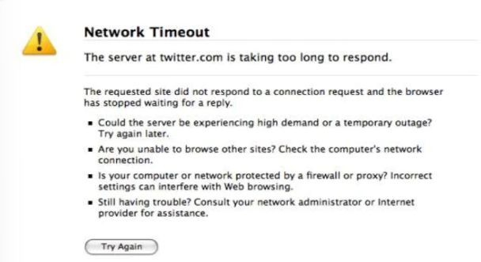
A common message after DOS

Slide 13
What to do if we are experiencing an attack?
Contact to your network administrators.
In case of home computer, consider contacting your internet service provider (ISP).
Immediately get disconnected from the internet.

Slide 14
How do we avoid being part of the problem ?
Install and maintain anti virus
Install a firewall
Configure the firewall to restrict incoming and outgoing traffic.
Follow good security practices for distributing your email address.
Applying email filters may help you manage unwanted traffic.

Slide 15
Conclusion
Susceptibility to attack could be alleviated with better internet.
Don’t leave all the decision making to the machines.
Provide “intelligent” support along the path.
Create “hardened” network

Slide 16


Thank You
Sameer Ansari
speaktosameernp@gmail.com
BCA 7th Sem

